Slide 1
Predictive Maintenance For Industrial Machinery Using Random Forest Algorithm
ZEROTH REVIEW
Guided By,
Senthil Prabhu,
Associate Professor,
Department of Artificial Intelligence and Data Science,
Karpagam Institute of Technology,
Coimbatore.
Presented by
R.K.BALAJEEY (721220243005),
T.M.FAZIL NIYAZDEEN(721220243013),
M.HARISH KUMAR(721220243017),
K.NISHANTHAN(721220243037),
Department of Artificial Intelligence and Data Science,
Karpagam Institute of Technology,
Coimbatore.

Slide 2
Introduction
Predictive maintenance has emerged as a transformative solution in the realm of industrial machinery management, leveraging the power of Machine Learning to optimize maintenance practices and mitigate operational disruptions.
In today's fast-paced industrial landscape, unplanned downtime can have severe consequences, leading to production delays, increased maintenance costs, and compromised product quality.
Traditional maintenance strategies, often based on fixed schedules or reactive approaches, struggle to address these challenges effectively.

Slide 3
Problem Identification
Unplanned Downtime:
Traditional maintenance schedules are often based on fixed intervals or reactive responses to breakdowns.
Inadequate Resource Allocation:
Reactive maintenance can lead to inefficient resource allocation, as maintenance teams are often dispatched based on urgent requests rather than well-planned schedules.
Delayed Problem Detection:
Reactive maintenance strategies only address issues once they become evident, missing the opportunity to detect early signs of degradation or anomalies that could signal impending failures.

Slide 4
Literature Survey
Predictive Maintenance For Industrial Machinery Using Random Forest Algorithm
“Machine Learning for Predictive Maintenance of Industrial Machines”,
- Ameeth Kanawaday, Aditya Sane
This paper explores the use of AutoRegressive Integrated Moving Average (ARIMA) forecasting on the time series data collected from various sensors from a Slitting Machine, to predict the possible failures and quality defects, thus improving the overall manufacturing process

Slide 5
Proposed Work
The supervised models are trained on the historic data while the same dataset is used to train the ARIMA model.
This system is then stacked together. For new and unseen production cycles, the ARIMA model predicts the values of the parameters for the rest of the production cycle and these values are fed to the supervised model to classify.
If the model predicts the cycle as a bad production cycle, necessary steps must be taken to avoid it from happening

Slide 6
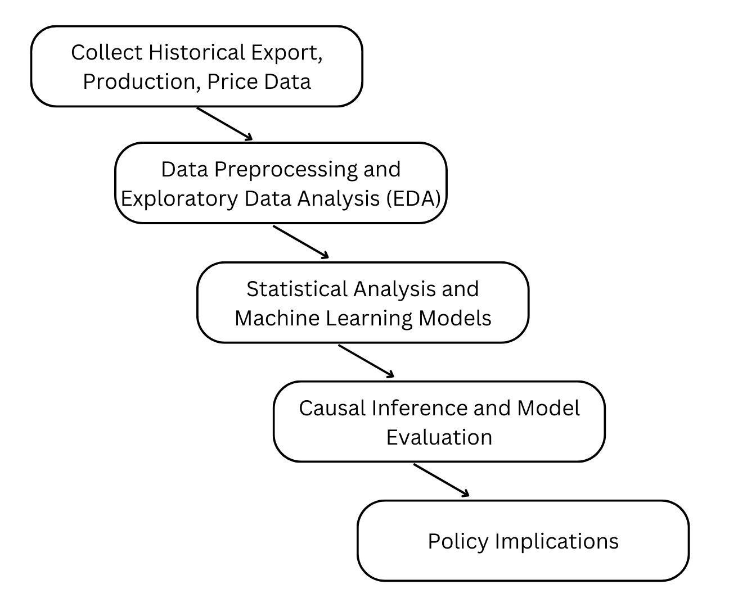
Overall Dataflow Diagram

Slide 7
Algorithm implemented
Random Forest Algorithm
Ensemble Algorithm: Random Forest constructs multiple decision trees.
Aggregate Predictions: Combines tree predictions for more accurate outcomes.
Overfitting Reduction: Effective for varied data, minimizes overfitting through averaging.
Gradient Boosting Algorithm
Iterative Improvement: Gradient Boosting builds trees sequentially, refining predictions with each iteration.
Residual Focused: Each tree corrects errors made by previous trees.
Strong Performance: Offers high accuracy, handles complex relationships, but may require tuning.

Slide 8
Expected Deliverables
Extended use of Machine life
Minimize Equipment Failure and Production Downtime
Accurate Predictions
Product Quality
Informed Decisions

Slide 9
References
Machine Learning for Predictive Maintenance of Industrial Machines
2021 9th International Conference on Reliability, Infocom Technologies and Optimization (Trends and Future Directions) (ICRITO)
Predictive Maintenance Applications for Machine Learning
2022 Advances in Science and Engineering Technology International Conferences (ASET)
Application of Machine Learning for Predictive Maintenance Cooling System in Hydropower Plant
2022 5th Information Technology for Education and Development (ITED)
Continual Learning of Fault Prediction for Turbofan Engines using Deep Learning with Elastic Weight Consolidation
2022 IEEE International Conference on Big Data (Big Data)

Slide 10
Thank You!

